Slide 1
Information Gathering

Slide 2
Analysis Phase
Gather, analyze, and validate the information.
Define the requirements and prototypes for new system.

Slide 3
Methods for Requirements Gathering
Interviews
JAD Sessions
Questionnaires
Document Analysis
Observation

Slide 4
Interviews
Interviews are of primary ways for information gathering where the system analyst will have face-to-face interaction with relevant stakeholders or subject matter experts.
Types of Interviews :
Unstructured Interviews
Structured Interviews

Slide 5
Types of Question
Types | Question for our interviewer
Close Ended Question | 1.Is This system is possible using current system? 2.How many days can be needed for implement the full system?
Open Ended Question | 1. What do you think about the system? 2. What can be the key features of this system? 3. How do this system can connect the addicted people simultaneously
Probing Question | Describe in details how it works? why do addicted people choose this system ?

Slide 6
JOINT APPLICATION DESIGN SESSIONS (JAD)
It is a technique where a workshop is facilitated and the entire system participants sit and discuss for the system analysis and defining requirements

Slide 7
JAD Participants
Executive Sponsor
Subject Matter Experts
Facilitator/Session Leader
Scribe/Recorder
Observers

Slide 8
QUESTIONNAIRES
Questionnaires are another way of information gathering where the potential users of the system are given questionnaires to be filled up and returned to the analyst.

Slide 9
Format for Questionnaires
Free format : Free format questionnaires will allow users to answer freely for each question
Fixed format: Fixed-format questionnaires contains questions that require a selection of predefined responses from individuals.

Slide 10

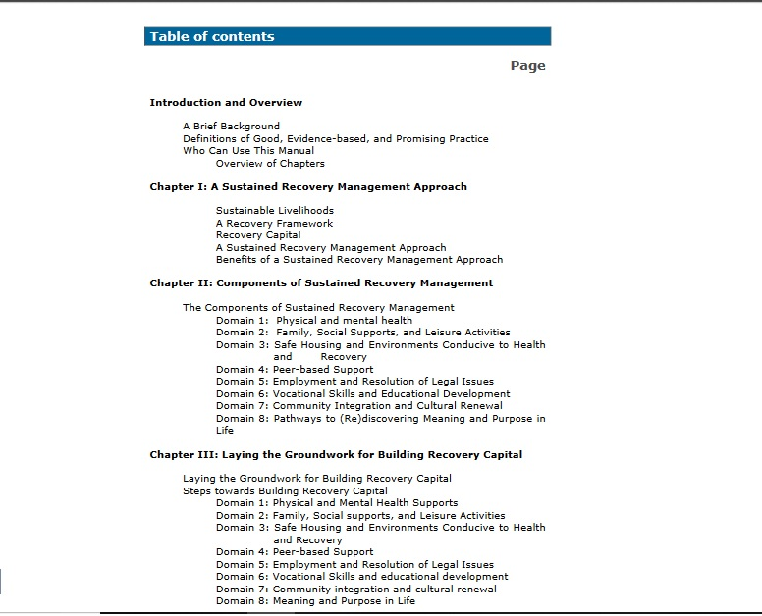
Document Analysis
Document Analysis is a technique used to gather requirements during the requirements elicitation phase of a project.

Slide 11
Observation
Observation is a systematic way to collect data by observing people in natural situations or settings
Types of Observation
1.Direct Observation
2.Indirect Observation

